Slide 1

AN EXPLORATION OF MACHINE LEARNING MODELS FOR SPATIAL-TEMPORAL METEOROLOGICAL FORECASTING
Drew Yohe
ECE 2372

Slide 2
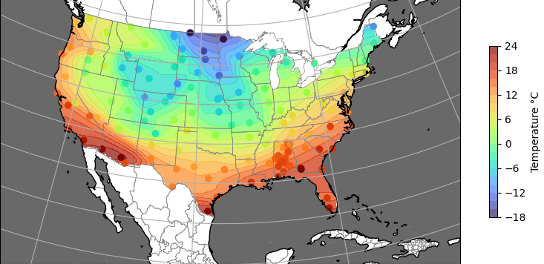

Background
Accurate long-term predictions of meteorological features such as temperature, precipitation have always been of public and private sector interest
Prior to the last decade, numerical physics models were best-in-class, but recently, ML approaches have started to outperform conventional models
This project explores which architectures have the most potential, and explores techniques that can be used to overcome difficulties in the process
Three architectures will be explored

Slide 3
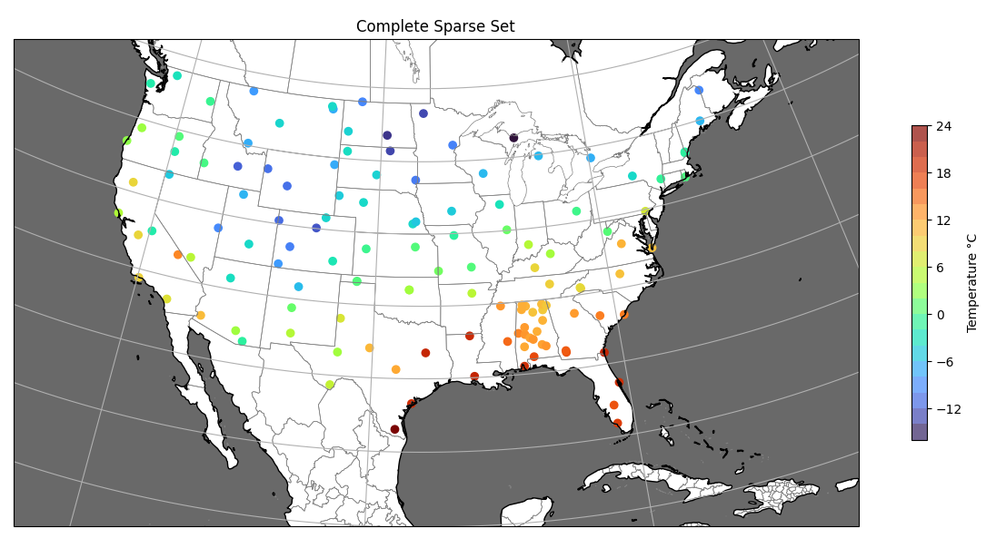
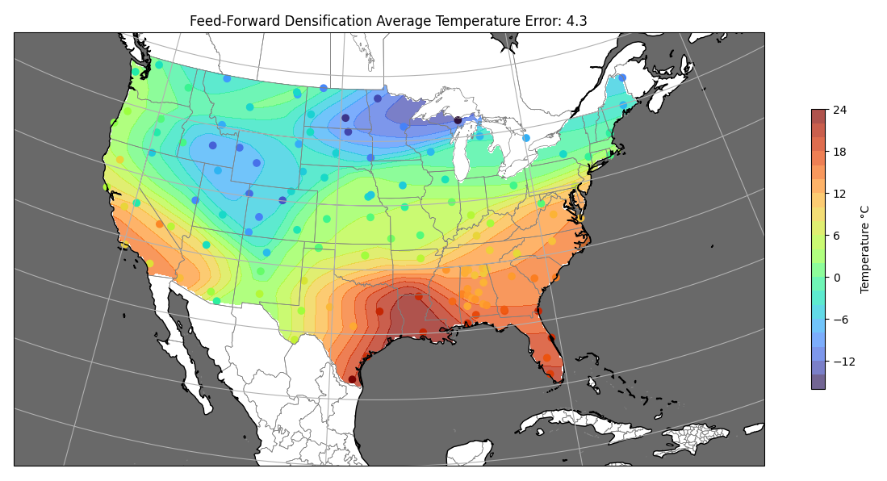
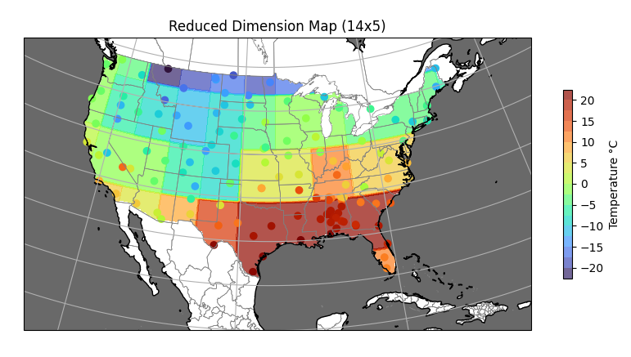
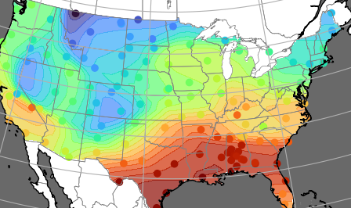
Outline
Densification Model
Dimensionality Reduction
Layer
Dense Spatial Feature Map
Reduced Dimension Spatial Feature Matrix
Raw Data
Time
Predictive Model
Expansion Model
Reduced Dimension Spatial Feature Prediction
Dense Spatial Feature Prediction
Reduced Dimension Spatial-Temporal Feature Tensor

Slide 4
Data Sourcing
The database used for training and assessment is the National Oceanic and Atmospheric Administration’s (NOAA) hourly weather data from the US Climate Reference Network (USCRN)
This provides sparse data across the United States of many features, such as solar radiation, soil temperature, relative humidity, atmospheric temperature, and precipitation
Figures in this presentation will primarily focus on temperature profiles, but the approach is generalizable

Slide 5
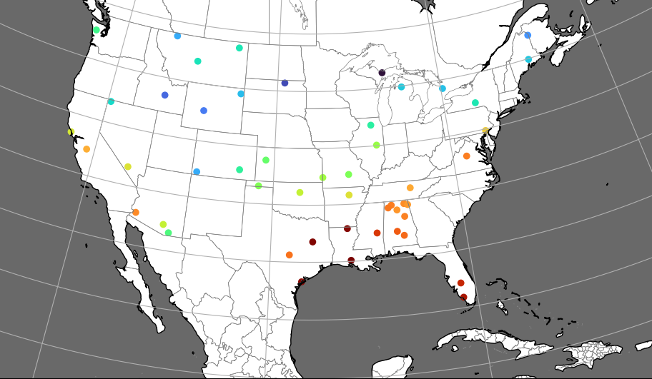
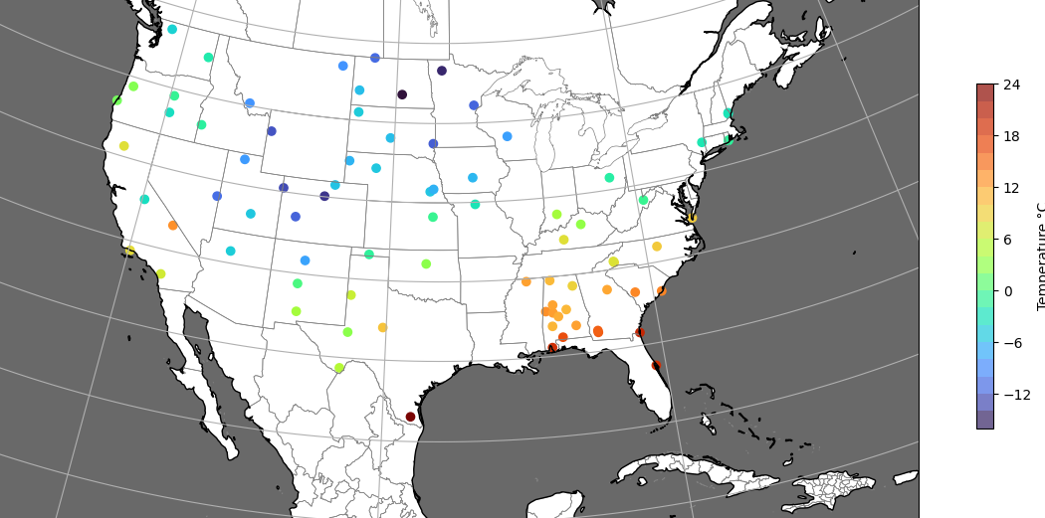
Densification - Approach
To develop appropriate training tensors, having data spatially uniform is critical
By dividing the complete data set into a training and testing subset, generalization of each model can be evaluated
Full Set (130 stations)
Training Set (50 stations)
Testing Set (80 stations)

Slide 6
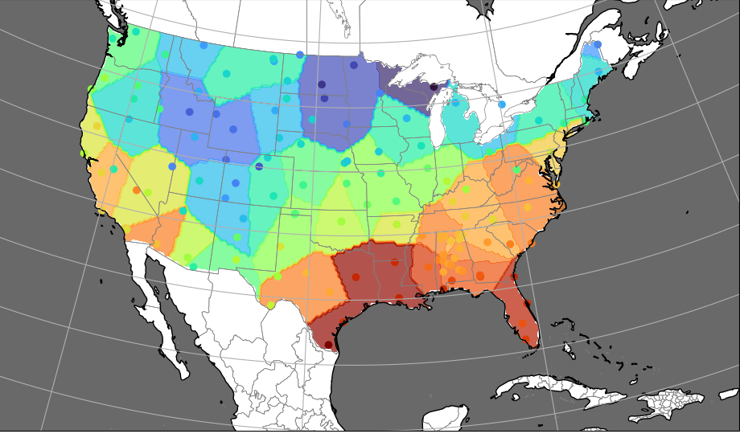
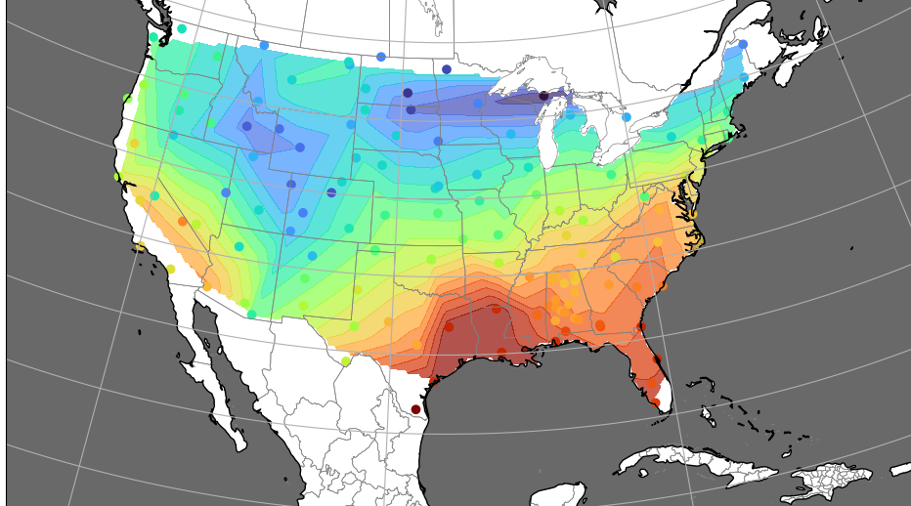
Densification - Models
Normalized coordinates
Normalized feature value
To develop appropriate training tensors, having data spatially uniform is critical
By dividing the complete data set into a training and testing subset, generalization of each model can be evaluated
1
2
128
128
256
Feed-Forward NN architecture for densification
(Leaky ReLU activation between layers)
Nearest Interpolation
Linear Interpolation
Feed-Forward NN

Slide 7
Densification - Results
Overall, the feed-forward architecture yielded the lowest generalization error and has other benefits, so feature densification will be performed with this model
Model Result | Nearest Interpolation | Linear Interpolation | Feed-Forward NN
Average Error (°C) | 4.89 | 4.47 | 4.30
Feature Map Continuity | Poor | Moderate | High
Map Coverage | Full | Partial | Full
Computational Complexity | Low | Low | High

Slide 8
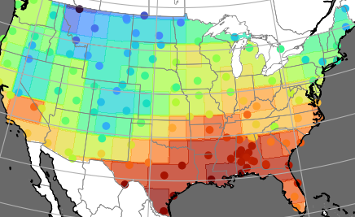
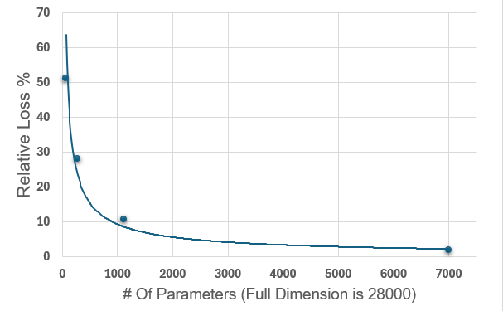
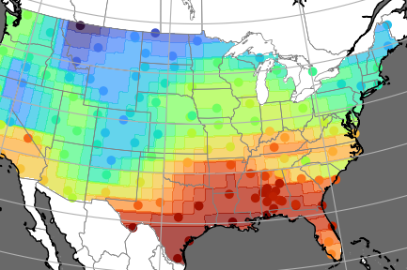
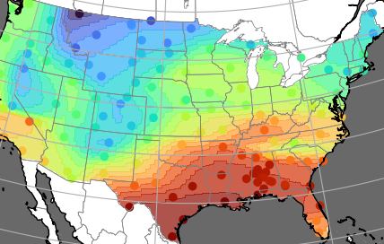
Dimensionality Reduction
Increasing the resolution of the feature matrix will improve the relative loss, but with a large increase in computational complexity. Ultimately 20x56 was chosen (1120 features)
5x14
10x28
20x56
140x50

Slide 9
Temporal Layering
Generating the spatial feature maps for 48 consecutive hourly time steps enables the creation of a layered tensor that contains normalized uniform spatial-temporal data, which is optimal for a predictive ML architecture
48 hours
20x56
48x20x56 (53,760 feature values)

Slide 10
Predictive Models – Feed Forward
48 hours
Prediction of next hour
Flatten
Reshape
128
256
1,120
20x56
48x20x56
512
53,760
All activation functions are leaky ReLU
Total Parameters: 27,834,336

Slide 11
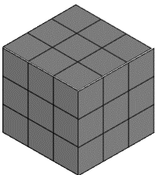
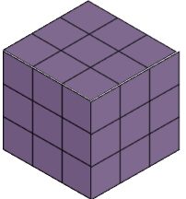
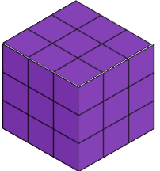
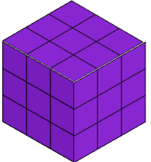
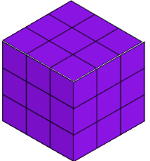
Predictive Models – 3D Convolution
48 hours
Prediction of next hour
Max Pool 3D
Max Pool 3D & Flatten
Reshape
128
256
1,120
20x56
48x20x56
32 Conv3d Filters (3x3x3)
512
64 Conv3d Filters (3x3x3)
53,760
All activation functions are leaky ReLU
1 Channel
32 Channels
64 Channels
1 Channel
Total Parameters: 28,001,056

Slide 12
Predictive Models – LSTM
48 hours
3 Layers
LSTM Cell
Prediction of next hour
LSTM Cell
LSTM Cell
1,120 inputs x 48 steps
1,120 outputs
Reshape
Reshape
128
256
1,120
20x56
48x20x56
512
1,120
All activation functions are leaky ReLU
Total Parameters: 31,125,600

Slide 13
Predictive Models – Expansion
Model Output
Dense Final Prediction
Normalized coordinates
Normalized feature value
1
2
128
128
20x56
256
100x280
Reuse densification network for expansion, but the training data is the reduced dimension output

Slide 14
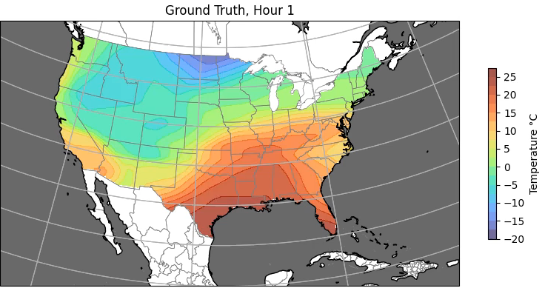
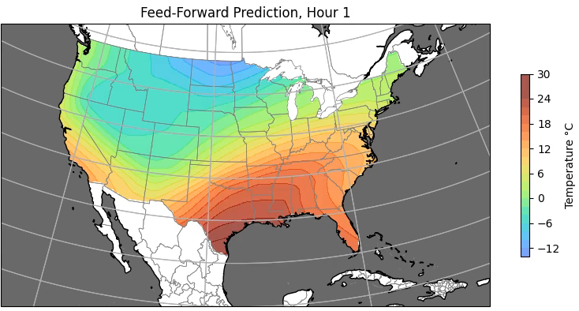
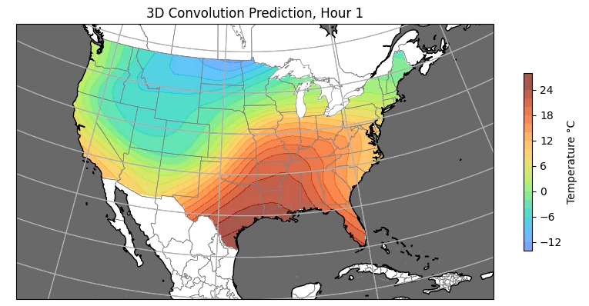

Predictive Models - Output

Slide 15
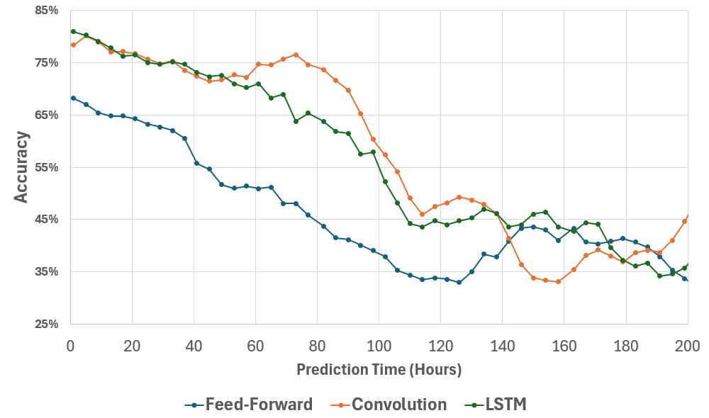
Predictive Models - Results
Accuracy is computed as the percentage of stations that are within 3°c of the true value
Overall, the 3D convolutional NN architecture had the best performance, however the LSTM model performed comparably and held steady, even at far-future time steps
The feed-forward network had poor early performance, dipping below 50% accuracy within 48 hours

Slide 16
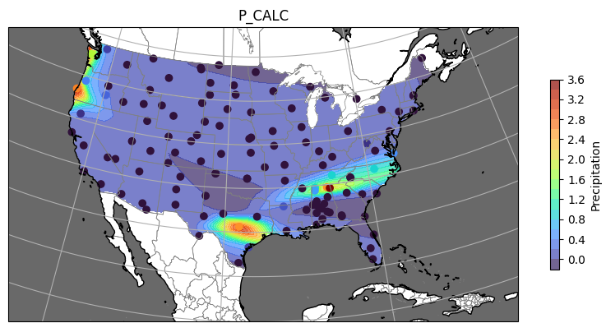
Discussion and Future Considerations
There are many architectures involved in the entire prediction process, many of which could benefit from further development
Hybridization of the best performing models could yield even better results than found here
Adding a fourth dimension to the feature tensor of additional weather values could add insight into feature interplay
Precipitation Map

Slide 17
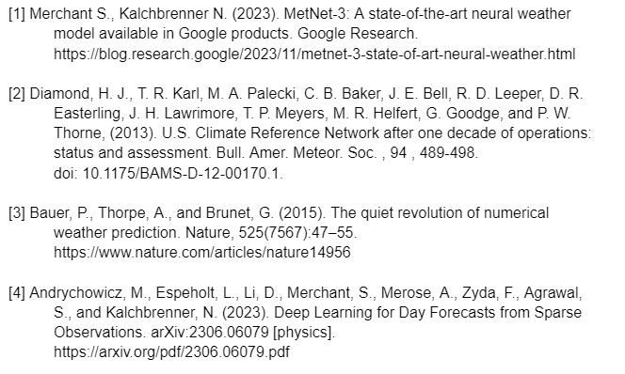
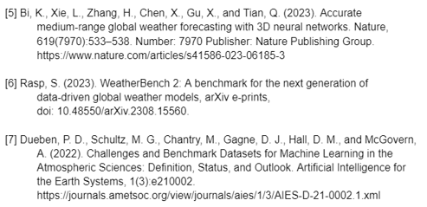
Referenced Literature

